Slide 1
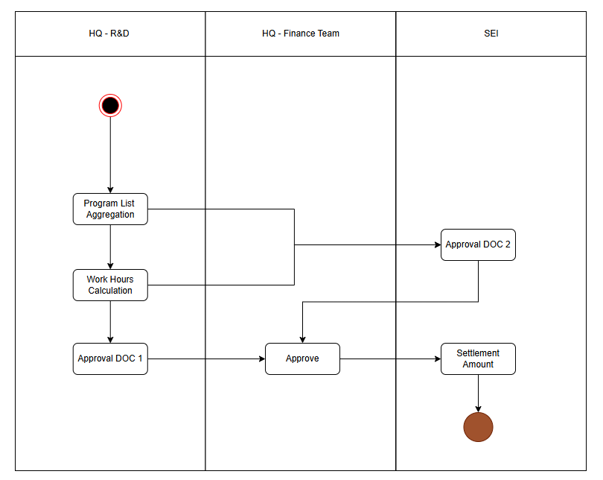

Slide 2




Process Menu Items
Type1. Process Items – Items used for displaying the main process
Items Without a Link
Other Module
Program Name
Same Module
Program Name
Manual Work
Bank
Customer
Program Name
Program Name
Program Name
Program Name
Program Name
Type2. 현황용 아이템 – 프로세스에 포함되지 않는 부가적인 아이템
Printouts
Linked Companies
Email Transmission
Program Name
Program Name
Program Name
Manual Work
Printouts
Other Items
File
URL
Email Transmission
Type3. 기타 아이템
Use it when additional explanation (item list) is needed.
Use it when an additional important explanation (item list) is needed.
Memo (Non-Recommendable)
File
URL
Mobile Inquiry
Mobile Entry
Use it when additional explanation is needed.
Use it when an additional important explanation is needed.
Type4. Group Items – Group a process
Distance
Distance
Mobile Inquiry
Only
Mobile Entry
Only
Introduction
Process Group
Process Area 1
Process Area 2
Settings
Status
Background Color

